Slide 1

Welcome to the Autumn
SEND Coffee Morning.
ELSA

Slide 2
ELSA
Emotional Literacy Support Assistant

Slide 3
What is Emotional Literacy?
Developing high self-esteem and positive interactions with others.
Building resilience.
Emotion coaching- being aware of the emotions you are experiencing.
Understanding why you might be feeling that way and knowing the most effective way for expressing you feelings and being able to put it into action.
Understanding and taking into account the feelings of others, then adjusting your response accordingly.
Being emotionally literate helps children focus better on their learning.

Slide 4

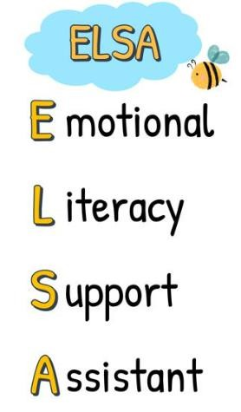
What is an ELSA?
They help children recognise, understand and manage emotions to increase success
They plan and deliver individual (and small group) support programmes
They receive training and supervision from an educational psychologist

Slide 5
Benefits of ELSA – for Pupils
Feeling supported and listened to
Develop greater
self awareness
and ability to talk
about feelings
Manage better in school and have coping strategies
Interact more successfully with others
Feel better about themselves

Slide 6
When is extra support useful?
These key areas of emotional development is what an ELSA may be able to support with in school:
Recognising and managing a range emotions.
Low self-esteem.
Difficulties with anger management.
Dynamic changes at home.
Difficulties self-regulating
Anxiety leading to school refusal.
Loss and bereavement.

Slide 7
Crisis situations
ELSA can also be used effectively to help a pupil cope during a crisis. This could include the death of a family member, divorce or separation, or a loved one having a serious illness.
In these situations, a referral would be acted upon immediately in consultation with the Senior Leadership Team and the pupil given a block of sessions to help them during the crisis. Sessions could be extended if needed due to nature of crisis.

Slide 8
ELSA Intervention
Pupils usually attend a block of between 6 sessions lasting 30 minutes each.
At the end of the block, the sessions will be evaluated and a decision made on whether the pupil requires further sessions.
The sessions are 1:1 and take place in a quiet space away from the classroom in a resource specific ELSA room.
The sessions are confidential unless information needs to be shared for
safeguarding issues.
A verbal contract is drawn up between pupil and the ELSA and referred to at start of each session.
Sessions are fun and might include role-play, game or art and craft activities. They include time to talk.
A pupil’s progress will be reviewed on a half-termly basis.

Slide 9
Typical ELSA Intervention
The sessions are very informal with the aim of providing the pupil a safe, comfortable place in which they can express themselves.
Each session begins with the sharing of the contract and check in of how
we are feeling.
Activities such as playing games, craft, yoga, stories, puppet work can
take place in a session – led by the pupil’s interests.
It is beneficial if the pupil is verbal as very difficult to do otherwise.
Depending of the nature of the issue, a related activity then normally takes place. These activities are not too demanding academically.

Slide 10
Referral of pupil
If you are concerned about your child’s social, emotional and mental health, please discuss your concerns with your child’s class teacher. If they feel ELSA could be an appropriate source of support, they will complete a referral to the ELSA.
There is a waiting list and support is not guaranteed to be immediate.
If your child has been accepted for ELSA intervention, you will receive a letter and information regarding when the support will begin.

Slide 11
Any Questions?

